Slide 1
Notes:
11175541

Slide 2
Notes:
11175541

Slide 3
HAPPY COFFEE DAY
Notes:
11175541

Slide 4
15,⁹⁰ €
NEW COLOR
Top Mug Coffee (2 pcs.)
SS244001
For any product
purchased from
this slide you
can add the Coffee
Measuring Spoon to
your order for only
1,00 €
PP244002
Notes:
11175541

Slide 5
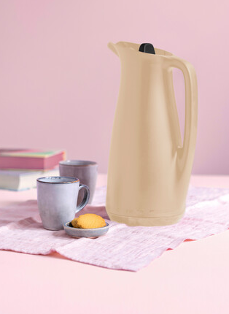
SAVE
30,⁹⁰ €
99,⁹⁰ €
69,⁹⁰ €
9,⁹⁰ €
6,⁰⁰ €
SAVE
3,⁹⁰ €
Thermotup Pitcher 1 L
SS244002
Thermotup Tea Insert
SS244003
NEW COLOR
For any product
purchased from
pages 2 to 5 you
can add the Coffee
Measuring Spoon to
your order for only
1,00 €
PP244002
Notes:
11175541

Slide 6
24,⁹⁰ €
19,⁹⁰ €
SAVE
5,⁰⁰ €
22,⁹⁰ €
Silicone Form - Mini Muffin
SS244004
Tupperkids Plates (4)
SS244005
For any product
purchased from this slide you
can add the Coffee
Measuring Spoon to
your order for only
1,00 €
PP244002
Notes:
11175541

Slide 7
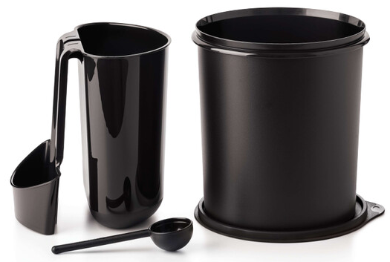
23,⁵⁰ €
My Coffee Station
SS244005
For any product
purchased from this slide you
can add the Coffee
Measuring Spoon to
your order for only
1,00 €
PP244002
Notes:
11175541

Slide 8
17,⁵⁰ €
13,⁵⁰ €
SAVE
4,⁰⁰ €
Condiserve Flip Cap Dispenser
SS244009
One Touch Canister 1,4L Coffee
SS244008
NEW PATTERN
10,⁹⁰ €
For any product
purchased from this slide you
can add the Coffee
Measuring Spoon to
your order for only
1,00 €
PP244002
Notes:
11175541

Slide 9
PINK OCTOBER
Notes:
NP013582

Slide 10
JOIN THE PINK WAVE
Together, we’re a force. Which is why for each Eco Bottle 2L with Pop-up Straw purchased, 2,00 € will be donated to a local foundation to help support the fight against breast cancer.
Eco Bottle 2 L With Pop-up Straw
SS244010
18,⁵⁰ €
Notes:
NP013582

Slide 11
EVERYDAY FAVORITE ITEMS
Notes:
11172889

Slide 12
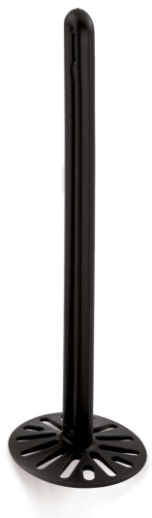
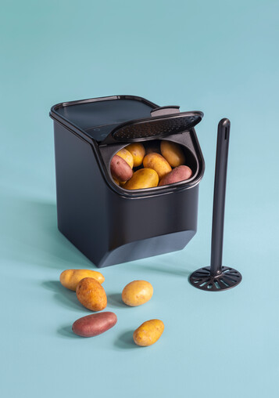
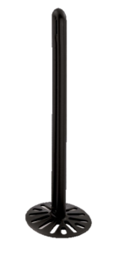
64,⁸⁸ €
44,⁹⁰ €
2x Potato Masher as a gift in the set price.
Potato Set
Potatosmart 5,5 L
Potato Masher (2 pcs.)
SS244011
Notes:
11172889

Slide 13
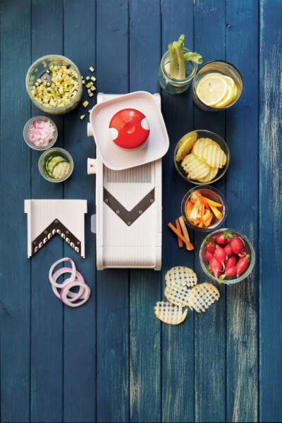
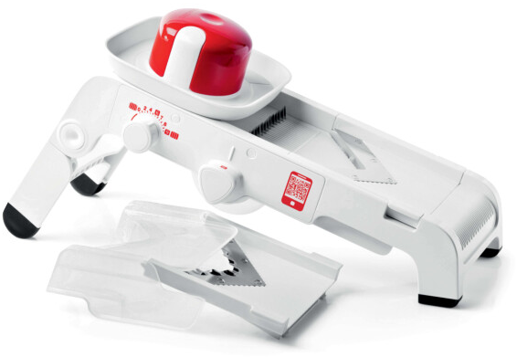
109,⁰⁰ €
59,⁵⁰ €
T.S. Mandochef
SS244012
SAVE
49,⁵⁰ €
Notes:
11172889

Slide 14
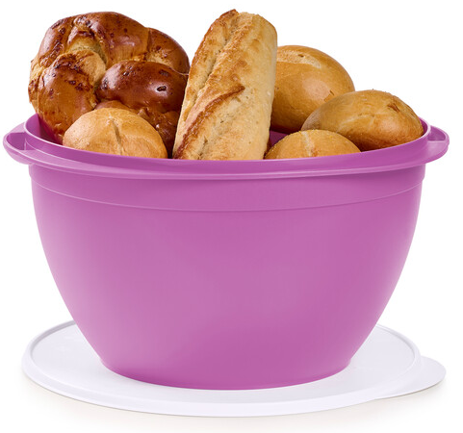
25,⁹⁰ €
Legacy Bowl 10 L
SS244013
Notes:
11133940

Slide 15
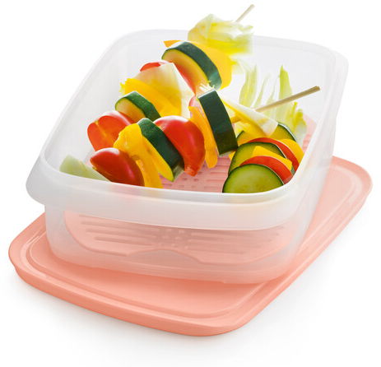
Cool Stackable
SS244014
17,⁹⁰ €
Notes:
NP013484

Slide 16
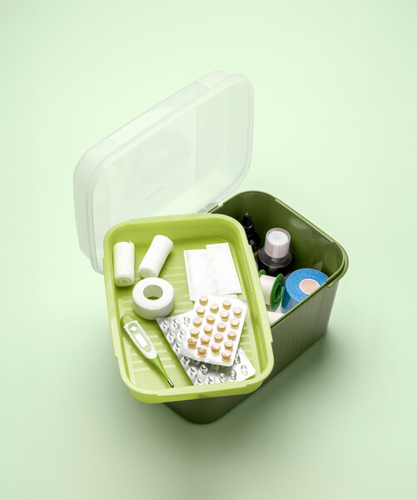
Multi Keeper With Tray
SS244015
34,⁹⁰ €
Notes:
NP013484

Slide 17
Bottles Set:
A. ECO+ Bottle Gen I 750 ml
B. ECO+ Bottle Gen I 500 ml
SS244016
Recycline Bottle N Can Organizer
SS244017
2,⁹⁰ €
30,⁸⁰ €
16,⁹⁰ €
ECO+ Bottle Gen I 500ml is a gift in the set price!
Notes:
11175541

Slide 18
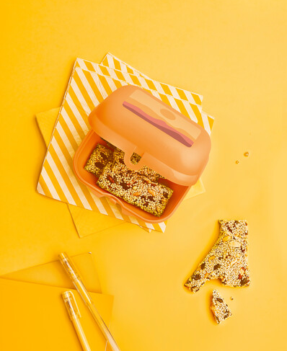
NEW PATTERN
Oyster Twins Large
SS244018
11,⁹⁰ €
7,⁹⁰ €
4,⁹⁰ €
Notes:
11175541

Slide 19
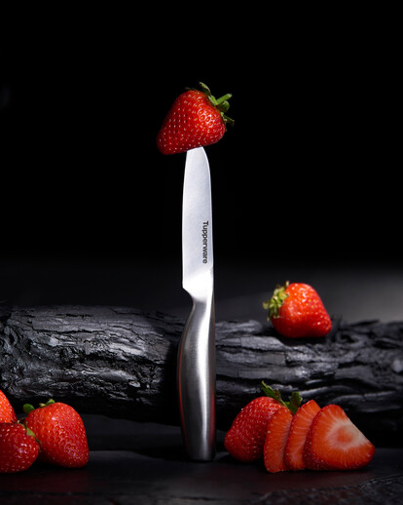
25,⁹⁰ €
Mastro Ph II Paring Knife
SS244019
Notes:
11164537

Slide 20
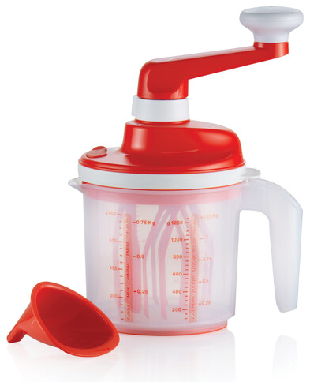
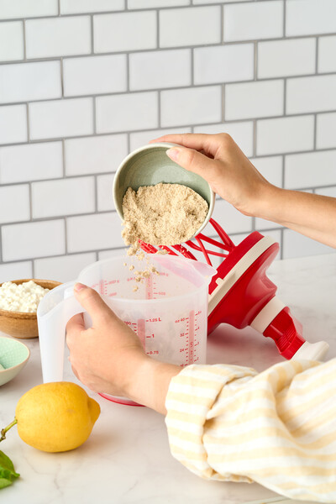
EZ Speedy 1,25 L
PP244001
74,⁹⁰ €
37,⁵⁰ €
For every order
of 50,00 € you
can buy the
EZ Speedy 1,25 L for a
special price!
SAVE
37,⁴⁰ €
Notes:
11164537

Slide 21
18,⁹⁰ €
9,⁹⁰ €
SAVE
9,⁰⁰ €
Easylogics Basting Brush
SS244020
Notes:
11164537

Slide 22
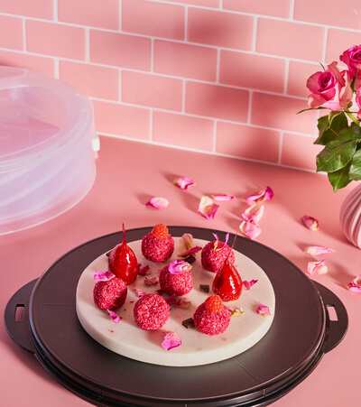
62,⁹⁰ €
39,⁹⁰ €
Collapsible Cake Taker
SS244021
SAVE
23,⁰⁰ €
Notes:
11164537

Slide 23
Premiaglass Plain Sqare Tray 1,9 L
SS244022
19,⁹⁰ €
Notes:
11164312

Slide 24
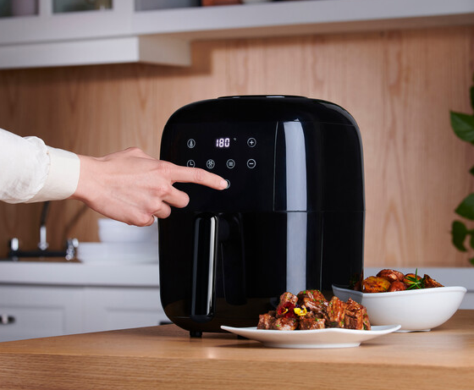
Air Fryer
SS244023
145,⁹⁰ €
Notes:
11164312

Slide 25
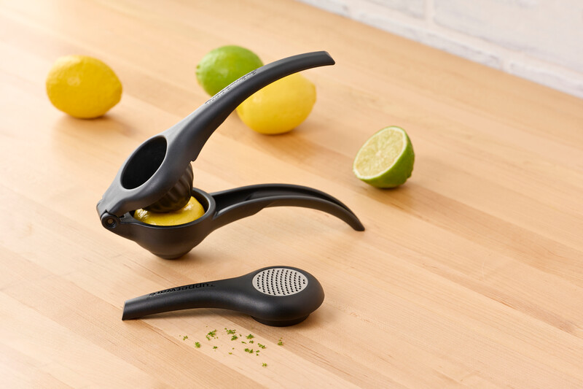
49,⁹⁰ €
36,⁹⁰ €
Ergologics Zest N Press
SS244024
SAVE
13,⁰⁰ €
Notes:
11164312

Slide 26
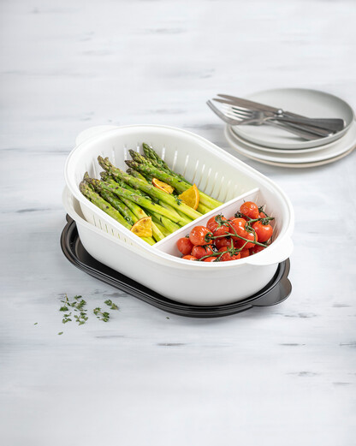
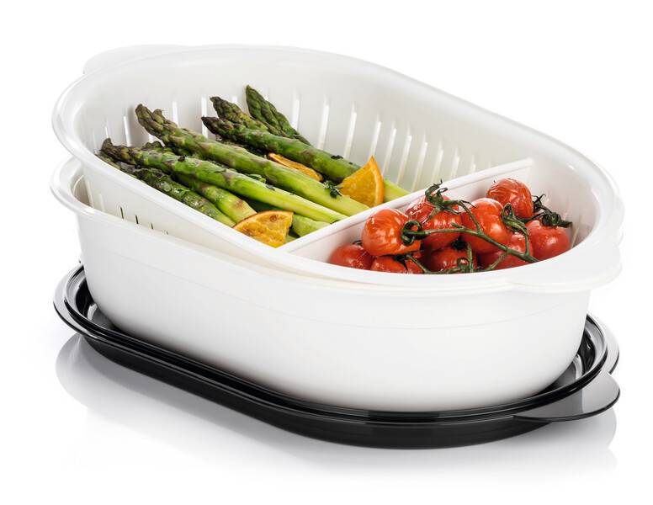
T.C. Oval Serving Dish 4 L
SS244025
36,⁹⁰ €
Notes:
11164312

Slide 27
OFFERS FOR
NEW CONSULTANTS
Notes:
11133940

Slide 28
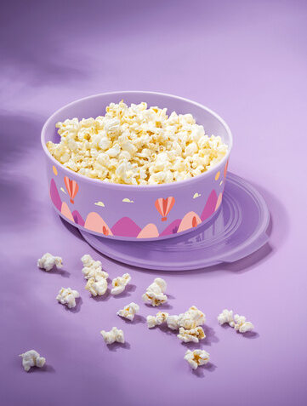
25,⁹⁰ €
Legacy Bowl 10 L
SS244013
Notes:
11133940

Slide 29
ECO+ Prisms Salad Tongs
SS244028
31,80 €
15,90 €
One Touch Fresh™ Small Square 810 ml (2 pcs.)
SS244027
31,80 €
15,90 €
1+1
25,⁹⁰ €
Recycline Microfiber Eye Glass (2)
SS244029
14,90 €
7,90 €
EZ Shaker 350ml
SS244030
18,90 €
9,90 €
SAVE
7,⁰⁰ €
SAVE
9,⁰⁰ €
Notes:
11133940

Slide 30
11,⁹⁰ €
2,⁹⁰ €
S.S. Bowl 1,4 L
SS244032
NEW
COLOR
Paddle scraper
SS244031
Notes:
11164537

Slide 31
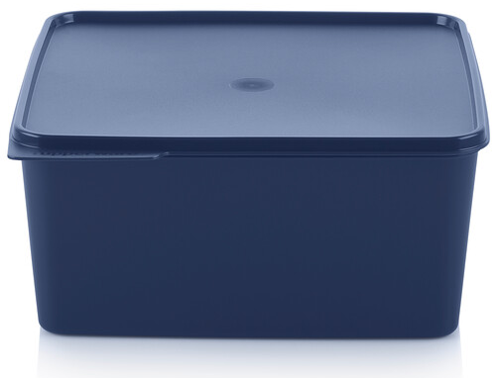
Dear HOSTESSES
Thank You Gift
Super Gift 1
Super Gift 2
For an order of at least 120 EUR and 1 fixed Party
and held in the next 3 weeks, you will receive:
Basic Line 500 ml
TG244001
For an order of at least 250 EUR and 2 fixed Parties and held in the next 3 weeks, you will
receive:
Basic Line 1,2 L
Basic Line 2,5 L
HG244001
and Thank you gift (TG244001 )
For an order of at least 350 EUR
and 2 fixed Parties and held in the next 3 weeks, you will receive:
Basic Line 5 L
Basic Line 1,2 L
Basic Line 2,5 L
HG244002
and Thank you gift (TG244001 )
XX €
XX €
Notes:
11153042

